Slide 1

Spreadsheet Project: Zomato Restaurants Analysis
Submitted By :Shivani Tiwari
Date : 13-10-2024

Slide 2
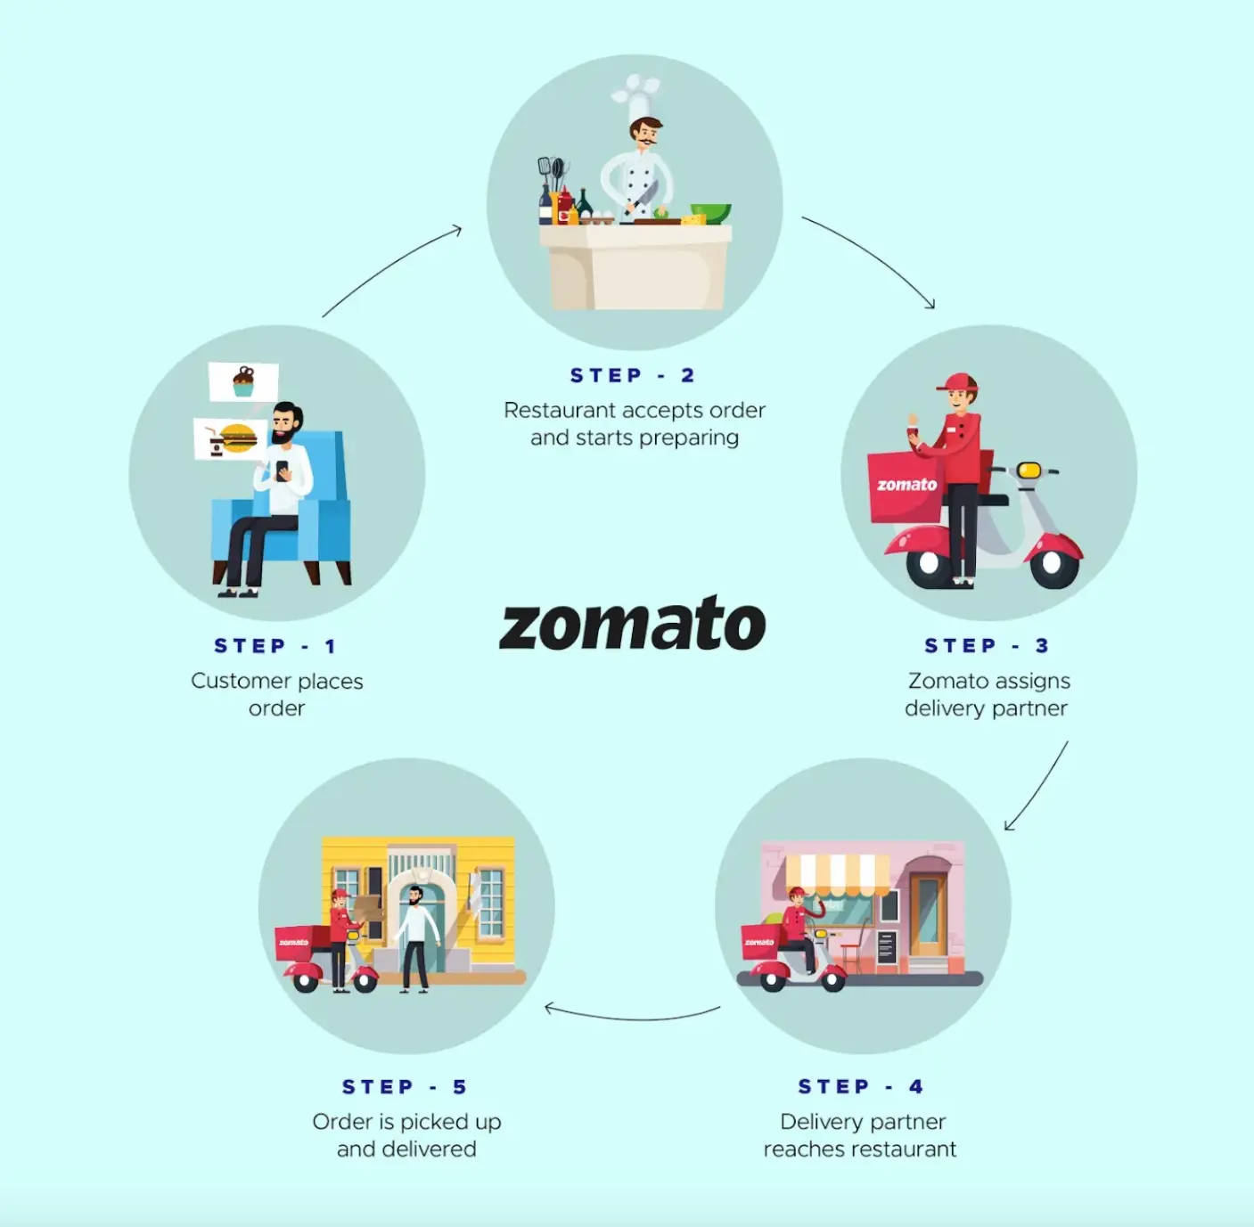
What is Zomato and How does it Work
Zomato is one of the most comprehensive and user-friendly apps for finding nearby restaurants and cafés to dine in or to order food online.
It also gives menus, reviews, and ratings to acquire factual information on eateries. Users can place orders from their preferred restaurant based on previous customers' ratings and feedback. It may be why many entrepreneurs are interested in creating a Zomato-like app. It provides users with convenience and assists business owners in taking their local food business to new heights.
Zomato's working model is simple. Customers have to follow these five simple steps-
Step 1
Users may browse and order food from various restaurants via the desiccated app or website.
Step 2
When restaurant owners receive an order request, they prepare a dish.
Step 3
As the food is prepared for delivery, it is given to delivery companies.
Step 4
The delivery service delivers food to the customer's preferred location.
Step 5
Customers can make purchases and provide evaluations based on their experience using the payment options.

Slide 3

Objective of Project
The food delivery and restaurant industry is experiencing rapid growth, with consumers increasingly seeking diverse dining options."
Surprising Fact: "In 2023, the global online food delivery market was valued at over $150 billion, and it's projected to grow significantly in the coming years."
Objectives:
Identify potential countries for Zomato's expansion.
Analyze market trends and restaurant distribution across different price ranges.
Gather data on customer satisfaction and feedback to improve service delivery.
Get information about competition levels and customer engagement in target areas by analyzing rating and votes of customers .
Analyze pricing strategies to ensure competitiveness while maintaining profitability.
Examine consumer preferences and behaviors in potential markets

Slide 4
Data Overview
Has_Table_booking: Indicates whether the restaurant has a table booking option (Yes/No).
Has_Online_delivery: Indicates whether the restaurant offers online delivery (Yes/No).
Is_delivering_now: Indicates whether the restaurant is currently delivering (Yes/No).
Switch_to_order_menu: Indicates whether users can switch to the order menu (Yes/No).
Price_range: A numeric value indicating the price range category of the restaurant.
Votes: The number of votes or ratings/(feedback) received by the restaurant.
Average_Cost_for_two: The average cost for two people dining at the restaurant.
Rating: The overall rating of the restaurant is based on user reviews.
Datekey_opening: The date when the restaurant was opened.
CountryCode: Country code of the location where the restaurant is situated
Restaurant ID: Unique identifier for each restaurant.
Restaurant Name: The name of the restaurant.
Country Code: Country code of the location where the restaurant is situated.
City: The city where the restaurant is located.
Address: The specific address of the restaurant.
Locality: The locality or neighbourhood where the restaurant is situated.
Locality Verbose: Detailed information about the locality.
Longitude: The geographical longitude coordinate of the restaurant.
Latitude: The geographical latitude coordinate of the restaurant.
Cuisines: The type of cuisine offered by the restaurant.
Currency: The currency used for transactions in the restaurant.
Country name: Respective country for given country code

Slide 5
Methodology
Data Cleaning
Identified missing values in cuisines column.
Addressing Inconsistent Values in Restaurants id column.
Used conditional formatting to identify extra spaces.
Removed extra spaces in "Address," "Locality," and "Locality Verbose" columns using the TRIM function for consistency.
Pre-Processing Steps
Used VLOOKUP to add the country based on the country code.
Adding relevant contextual information improves the dataset’s utility and helps in better segmentation during analysis.
Extracted opening month and year from "Date Key Opening" using the TEXT function.
Enhances analysis by allowing for trend assessments over time, critical for understanding restaurant performance.
3. Data Analysis Tools:
Utilized Pivot Tables and Pivot Charts for summarizing and visualizing the data.
These tools allow for dynamic data exploration and insightful visual representation, facilitating better understanding and communication of findings to stakeholders.
CONCLUSION
By addressing missing values and inconsistencies, and enriching the dataset, the analysis can yield reliable insights, ultimately supporting informed decision-making.

Slide 6
KEY METRICS AND VISULAIZATION
NUMBER OF VOTERS
Evaluated the average number of voters per restaurants by country , providing a comparative analysis of customer engagement.
Country with high number of votes depicts higher interaction with customers.
Example : Indonesia, Philippines.

Slide 7
Count of Restaurants
Calculated the total number of restaurants per country and also explored yearly count of restaurants .
Visualizing these insights through pivot table and pivot chart for better strategic decision making.
It will be very helpful in opening of new restaurants. Like – Canada, Australia

Slide 8
AVERAGE RATING Of RESTAURANTS IN EACH COUNTRY
Utilized statical method to calculate average rating of restaurants in each country for improvements and strategic adjustments.
It is important to see the current rating of restaurants to make the marketing strategies and analyse the performance.
Low Rating: There need to be improvements. Example - Australia, Canada
High Rating: Such countries hold high market demands. Example – Indonesia, Philippines

Slide 9
Suggestions for Country
To determine countries where team can open newer restaurants with lesser competition, I used following parameters to visualize through pivot table and chart.
Density of Restaurants
Compare No of restaurants in each Country
Geographical size of the country
1 | Canada
2 | Australia
3 | Brazil
4 | India
5 | Indonesia
6 | South Africa
7 | Turkey
8 | United States of America
9 | United Kingdom
10 | Philippines
11 | New Zealand
12 | Sri Lanka
13 | United Arab Emirates
14 | Qatar
15 | Singapore

Slide 10
B. Position of Restaurants in Market
1.Average rating 2.Average No of Votes
Countries with high number of average voting have high chances of customers interaction which is good in terms of stable ratings marketing demand. Rating with fewer votes have more susceptible to fluctuations.
It is important to see the current rating of restaurants to make the marketing strategies and analyse the performance.

Slide 11
Suggested Countries
Canada
Canada has only 4 opened restaurants .
One of the lowest average rating indicating that restaurants quality is not high and here it need to be improvement.
Lowest average voting indicating that there is less customers interaction and more susceptible to fluctuations.
New restaurants can be opened here because of less competition and scope of improvements.
Australia
Australia has 24 restaurants .
Second lowest average rating of restaurants .
Second lowest average voting
New restaurants can be opened here because of less competition and scope of improvements.
Indonesia
Less number of restaurants and bigger in geographical size as compared to all other countries having same number of restaurants.
One of the highest average rating and impressive customer interactions.
New restaurants can be opened because of less number of restaurants and high market appeal.

Slide 12
4. Philippines
Philippines has 22 restaurants .
One of the highest average rating and impressive customer interactions.
New restaurants can be opened because of less number of restaurants and high market appeal.
5. South Africa
South Africa has 60 restaurants .
It has large geographical size .So , newer restaurants can be opened here.
One of the highest average rating and bigger data of customers interaction.

Slide 13
CUISINES TO FOCUS FOR NEWER RESTAURANTS
To decide Cuisines , we will focus on two factors : Cuisine’s Rating and Total Votes on each cuisines.
Canada , Australia and Indonesia , cuisines with Highest Number of Average Rating also got Highest Number Of Total Votes.
Countries like Philippines and South Africa, some of the highest rating (4.8-4.9)cuisines have less number of votes than the cuisines having less number of rating(4.5-4.7) .
So it was better to choose those cuisines which have rating >= 4.5 and good number of votes.
With fewer votes and high rating like 4.9 , restaurant’s cuisines is more susceptible to fluctuation.
Rating like 4.5 with good number of votes is more stable and reliable.
Australia | Average of Rating | Sum of Votes
American, Bakery, European, Burger, Fusion | 3.5 | 37
Asian | 4.1 | 40
Breakfast, Coffee and Tea | 3.6 | 18
Burger, Coffee and Tea, Modern Australian | 3.8 | 97
Cafe | 3.533333333 | 150
Cafe, Coffee and Tea, Sandwich | 4.4 | 339
Chinese | 4.1 | 87
Coffee and Tea, Tapas, Australian | 3.8 | 93
Finger Food | 3.75 | 75
Indian, South Indian | 3.7 | 351
Italian, French, Bakery, Cafe | 2.4 | 193
Italian, Fusion, Cafe | 3.5 | 25
Japanese, Korean | 4.4 | 381
Lebanese, Arabian, Middle Eastern | 2.9 | 11
Mediterranean, Italian | 3.8 | 192
Mediterranean, Seafood | 3.6 | 96
Modern Australian | 3.6 | 253
Modern Australian, Australian | 3.8 | 176
North Indian, Asian, Continental | 3.5 | 31
South American | 3.6 | 29
Indonesia | Average of Rating | Sum of Votes
American, Fast Food, Steak, Beverages | 4.2 | 395
Asian, Chinese | 4.6 | 903
Bar Food, Brazilian | 4.2 | 22
Brazilian | 4.4 | 410
Brazilian, Grill | 4.4 | 841
Cafe | 4.2 | 259
Cafe, Italian | 4.1 | 1498
Cafe, Tapas, South African, Beverages, Healthy Food, Desserts, Spanish | 4 | 1159
Contemporary, Burger, European | 4.3 | 458
Contemporary, Sushi, Grill, Italian, Steak | 4.6 | 1476
Filipino, Mexican | 4.9 | 1640
Indian, North Indian, Chinese | 4 | 331
Korean | 4.9 | 605
Restaurant Cafe, Desserts | 4.9 | 2212
Street Food, Burger, American, Finger Food, German | 4.9 | 1662
World Cuisine | 4.3 | 243

Slide 14
.
Philippines | Average of Rating | Sum of Votes
American | 4.9 | 1070
American, Asian, Italian, Seafood | 4.5 | 618
American, Ice Cream, Desserts | 4.5 | 211
Asian, Continental, Italian, North Indian | 4.5 | 591
Cafe | 4.65 | 412
Cafe, Bakery, American, Italian | 4.4 | 392
European, Italian, North Indian | 4.7 | 535
Indian, Street Food | 4.8 | 532
Italian | 4.4 | 270
Japanese, Korean | 4.8 | 229
Japanese, Sushi | 4.9 | 365
North Indian, Mughlai | 4.8 | 314
Pizza, Grill | 4.4 | 336
Ramen, Japanese | 4.9 | 621
South Africa | Average of Rating | Sum of Votes
African | 4.7 | 373
Cafe | 4.8 | 319
Cafe, Continental, North Indian | 4.9 | 85
Cafe, Kiwi | 4.5 | 97
Contemporary, Italian | 4.8 | 542
Continental, South African, Beverages, Desserts, Seafood, Grill, Ice Cream, International | 4.5 | 222
European, Contemporary | 4.9 | 441
European, South African | 4.6 | 892
European, South African, Steak | 4.5 | 287
Indian, Street Food | 4.5 | 328
Mediterranean | 4.5 | 356
Tapas | 4.9 | 194
Canada | Average of Rating | Sum of Votes
Breakfast, Coffee and Tea | 3.7 | 176
Italian, Mediterranean, Pizza | 4.3 | 204
Singaporean, Chinese, Seafood, Malay, Indian | 3.3 | 26
Thai, Chinese, Japanese | 3 | 6

Slide 15
Top 10 Cuisines

Slide 16
BOOKING OPTIONS AND DELIVERY OPTIONS
Table Booking
Online Delivery
Table Booking | Average of Rating
No | 2.809686644
Yes | 3.482556131
Online Delivery | Average of Rating
No | 2.754309859
Yes | 3.288004896
Conclusion:
There are 1158 restaurants that offer table booking, and 8393 restaurants that do not offer this service.
There are 2451 restaurants that offer online delivery, and 7100 restaurants that do not offer this service.
Highest average rating offers both service Table Booking and Online Delivery.
Lowest average rating neither offer Table Booking nor Online Delivery.
Table Booking and Online Delivery option should be considered in newer restaurants.

Slide 17
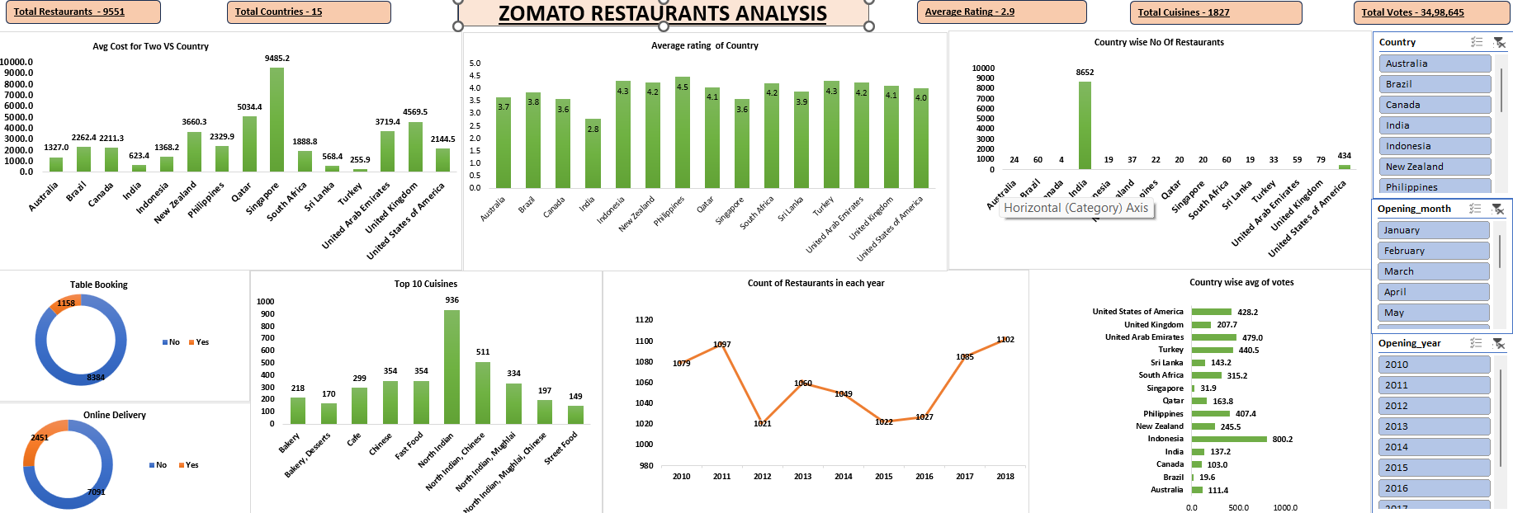
DASHBOARD

Slide 18

Strategic Recommendations
Focus on opening of new restaurants in countries with high potential and favourable competition .
Prioritize country with lower restaurants density for optimal market entry.
The analysis of restaurant density indicates areas with potential for growth or increased customer engagement.
Strategic expansion leading to higher profitability.
Identifying the biggest competitors helps in understanding market and their strategies. This information can help in differentiation strategies for newer restaurants.
Understanding customer sentiment can provide insights into preferences and areas for improvement and high quality cuisines and strategic pricing help to attract and retain customers effectively .
Implement online delivery and table booking system enhance customers satisfaction and improve rating and vote.

Slide 19
CONCLUSION
Key Findings and Implications
Top Cuisines: Identified the 10 highest-rated cuisines, providing a clear view of customer preferences and helping target marketing strategies effectively.
Market Opportunities: Highlighted regions with significant restaurant density and performance, suggesting optimal areas for expansion and new location openings.
Customer Satisfaction: Analyzed average ratings alongside the number of restaurants, advocating for enhanced cuisine variety and quality to improve customer experiences.
Data Integrity: Addressed inconsistencies in restaurant IDs and missing values, reinforcing the importance of clean data for reliable insights and decision-making.
This analysis not only uncovers critical insights about market dynamics and customer preferences but also paves the way for strategic actions that can enhance market penetration and customer satisfaction

